Slide 1
Path Models
Example 2
Chapter 2

Slide 2
Files and Pages
Load the chap2.R file.
Pages 29-31
We are going to do a regular regression example and a mediation example.

Slide 3
Create Correlation / Covariance Matrix
lower2full function → renamed to lav_matrix_lower2full
lower2full(ALL THE NUMBERS ALL THE TIME)
But only the lower half of the table.

Slide 4
Create Correlation / Covariance Matrix
 | Var 1 | Var 2 | Var 3
Var 1 | 1
Var 2 | .34 | 1
Var 3 | .53 | .63 | 1
lav_matrix_lower2full(c(1, .34, 1, .53, .63, 1))
Correlation tables have the 1s on the diagonal
Covariance tables have raw numbers on the diagonal
For this function, doesn’t matter
Helps if you label them .cov or .cor in the variable name.

Slide 5
Give the matrix a name
colnames(matrix) = rownames(matrix) = c(“Stuff”, “Stuff”, “Stuff”)
Click on it in the environment window to make sure it looks correct.
The names should be going down the side and across the top.

Slide 6
Build a Model
model = ‘
Y ~ X1 + X2 + X3
‘
Or we can talk about labeling the parameters:
Y ~ a*X1 + b*X2 + c*X3
Y ~~ z*Y
1

Slide 7
Run the Model
We talking the last video about running models with real data … in this example we just have a correlation table.
How do we estimate without the real data?
sem(model,
sample.cov=correlation table,
sample.nobs=number of people)

Slide 8
Get the summary
summary(model fit, rsquare = T)
In this example, we are going to look at r squared values – generally you want to leave this function on.

Slide 9
Interpret the summary
Look at:
df
Each path coefficient
The error variance
R square values

Slide 10
Create a picture
semPaths(model fit,
whatLabels="par",
layout="tree")

Slide 11
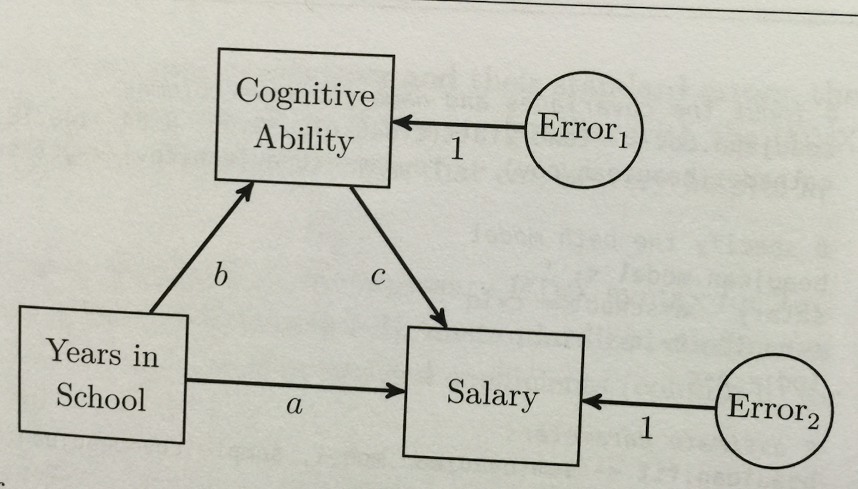
Mediation Example

Slide 12
Input the data
See table at the bottom of page 31.
This version is a covariance matrix.
Notice how we only entered the bottom half of the table.
beaujean.cov = lav_matrix_lower2full(c(648.07, 30.05, 8.64,
140.18, 25.57, 233.21))

Slide 13
Name the matrix
colnames(covariance) =
rownames(covariance) =
c("salary", "school", "iq")

Slide 14
Build the model
beaujean.model = 'salary ~ a*school + c*iq
iq ~ b*school # this is reversed in first printing of the book
ind:= b*c '

Slide 15
Run the model
sem(model,
sample.cov = covariance table,
sample.nobs = observations)

Slide 16
Get the output
summary(model fit, rsquare = T)
Interpret the output:
Path coefficients
Indirect effect
R square
Error variances

Slide 17
Create a picture
semPaths(model fit,
whatLabels="par",
layout="tree")

